Slide 1
Shipment Pricing Prediction
PARVEJ ALAM ANSARI
IBM Advanced Data Science Capstone

Slide 2

Use Case
The market for supply chain analytics is expected to develop at a CAGR of 17.3 percent from 2019 to 2024, more than doubling in size.
This data demonstrates how supply chain organizations are understanding the advantages of being able to predict what will happen in the future with a decent degree of certainty.
Supply chain leaders may use this data to address supply chain difficulties, cut costs, and enhance service levels all at the same time.

Slide 3
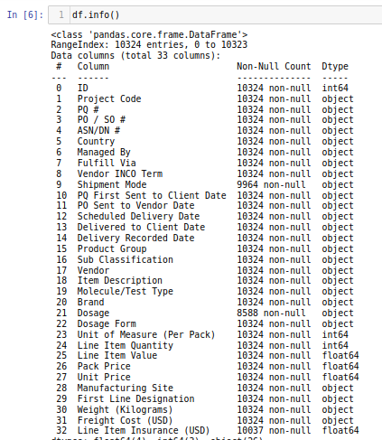
Dataset
The dataset was obtained from USA Government Website
(https://data.usaid.gov/HIV-AIDS/Supply-Chain-Shipment-Pricing-Data/a3rc-nmf6)
Dataset consists of 10324 samples and 33 features of which 26 are categorical and 7 are numerical.

Slide 4
Data Quality Assessment
In Dataset, outof 33 features, 3 features contain missing values.
Some duration values were negative suggesting outliers or missing values
The numerical features are highly skewed and categorical features needs to be properly handled.
There were no Duplicates in the dataset.

Slide 5
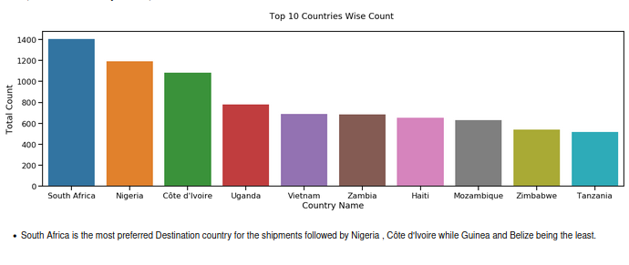
Exploration and Visualization
South Africa and Nigeria are most preferred Destination country for shipments.

Slide 6
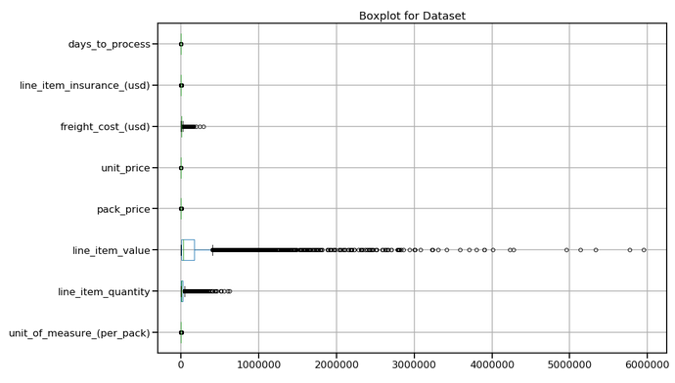
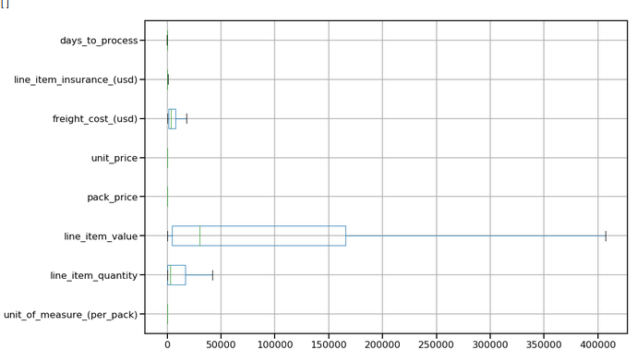
Exploration and Visualization
Enhanced Box Plots for outlier Detection

Slide 7
Feature Engineering
Missing values were properly handled as pre the need.
Each numerical values was clipped to remove outliers.
Categorical variables were converted to Numerical one for processing.
Feature Scaling was performed using MinMax scaler.
Numerical features and Categorical features were preprocessed for better performance of the ML Algorithms.

Slide 8
Model Selection
Two models were uses:-
Gradient boosted tree implemented with LightGBM
Deep Neural Network implemented with Keras
Hyper-parameters For each models were optimized using Bayesian optimization
The models were evaluated on all 3 three feature sets.

Slide 9
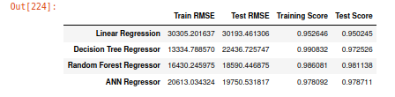
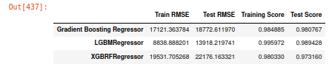

Results

Slide 10
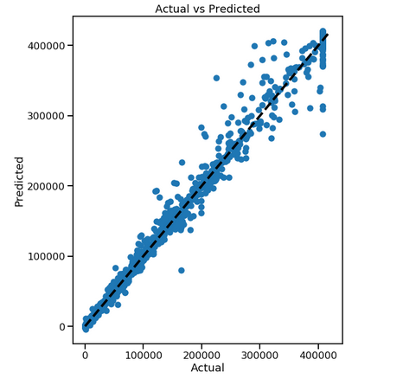
Results

Slide 11
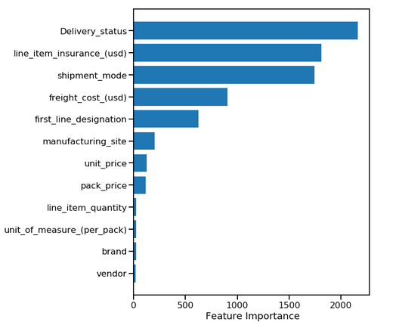
Results
TOP 12 most important features

Slide 12
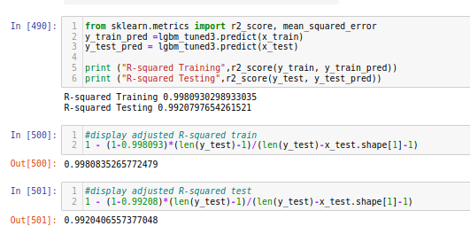
Model Performance Indicator

Slide 13
Conclusion
Dataset was cleaned , explored and visualized
Top 12 correlating features were isolated
Multiple Classical Machine Learning Algorithms and One Deep Learning based Neural Network was implemented against the data set to check the best performant algorithm.
LightGBM ML Algorithm was selected for model traning and testing.
Testing Accuracy is more than 99 precent.

Slide 14
THANK YOU

